Slide 1
Visual SLAM
Amulya Huchachar

Slide 2
Simultaneous Localization And Mapping
“Is the computational problem of constructing or updating a map of an unknown environment while simultaneously keeping track of an agent's location within it.” - Wikipedia
Localization : Tracking agent in a given Map.
Mapping : Constructing or updating a Map of a agent.
SLAM is a Chicken and Egg problem, which makes it very hard to solve.

Slide 3
Applications
Self Driving Cars.
Unmanned Aerial Vehicles.
Delivery Drones.
Mapping the environment.

Slide 4

Pipeline

Slide 5
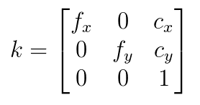
Camera Calibration
Determine intrinsic parameters of the camera.
Undo image distortions
  Radial Distortion : This causes straight lines to appear curved, becomes larger the farther points are from the center of the image.
  Tangential Distortion : This occurs because the image-taking lense is not aligned perfectly parallel to the imaging plane. So, some areas in the image may look nearer than expected.

Slide 6
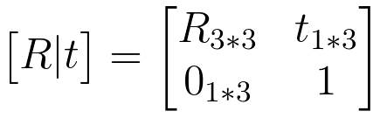
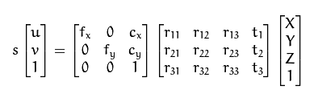
Pose and Depth
Determine extrinsic parameters of the camera (Pose).
Determine 3D position of a point (Depth)

Slide 7
Feature Matching
Find features in a pair of images
  OpenCV function `goodFeaturesToTrack` used to find Shi-Tomasi Corner Points.
ORB (Oriented FAST and Rotated BRIEF) is used to match features.
  ORB is a fusion of FAST keypoint detector and BRIEF descriptor
  Uses FAST to find keypoints, then apply corner measure to find top N points among them.
  Uses pyramid to produce multiscale-features.
  Computes the intensity weighted centroid of the patch with located corner at center. The direction of the vector from this corner point to centroid gives the orientation.
Shi and C. Tomasi. Good Features to Track. Proceedings of the IEEE Conference on Computer Vision and Pattern Recognition, pages 593-600, June 1994.
Ethan Rublee, Vincent Rabaud, Kurt Konolige, Gary R. Bradski: ORB: An efficient alternative to SIFT or SURF. ICCV 2011: 2564-2571.

Slide 8
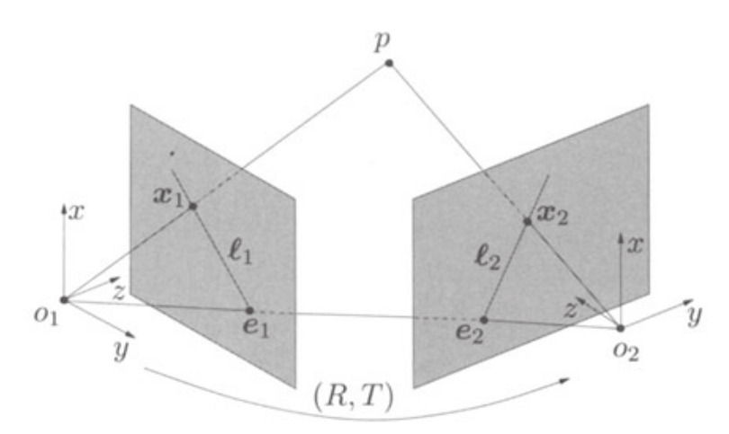
Epipolar Geometry
Pose is estimated by finding the image correspondence.
The pose change between frames contains a rotation R and translation T, which are together represented by Fundamental or Essential Matrix.
The fundamental matrix is an algebraic representation of epipolar geometry.
They are estimated by a nonlinear optimization, which tries to minimize the squared 2-norm of residuals called the reprojection error.
Estimated pose is used to triangulate a 3d point.

Slide 9
Graph Optimization
Efficient way to solve a complex nonlinear optimization problem is to represent them in graphs.
Keyframes are represented as nodes.
Helps solve loop closure and global optimization.
G2O library is used to achieve this.
Bundle Adjustment
BA is used to solve the Reprojection error - which is a geometric error corresponds to the image distance between projected point and a measured one.

Slide 10
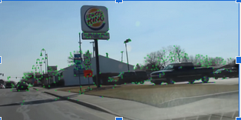
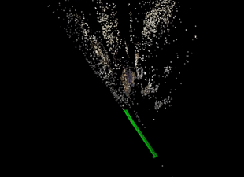
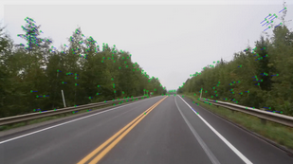
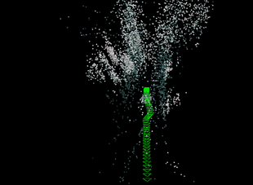
Demo

Slide 11
THANK YOU

